Slide 1
Weather App Modernization

Slide 2
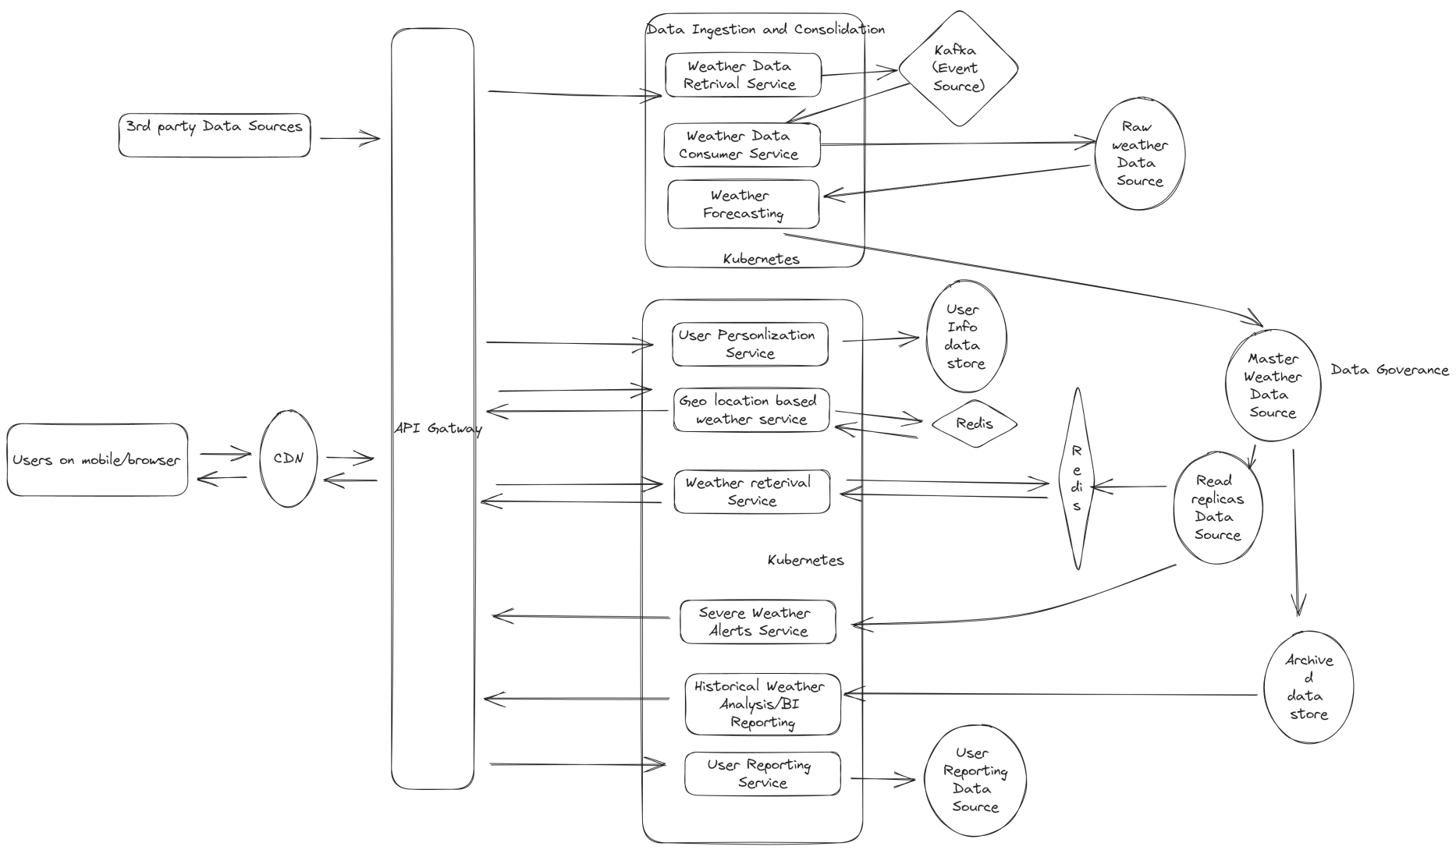
Weather App Target State

Slide 3
Micro services
Data Ingestion and consolidation
Weather Retrieval Service: Application for data ingestion from 3rd party sources and capture it in event store.
Weather Consumer Service: Application for reading incoming data from event store and persists it in database.
Weather Forecasting Service: Application for transforming raw data into processed weather information for storage and consumption
User experience and scalability
Geo location Weather Service:
Weather Retrieval Service
User Personalization Service
User Reporting Service
Severe Weather Alert Service

Slide 4
Micro services – Tech Stack
Tech Stack
SpringBoot/Quarkus/ Node.js – for micro services.
React/ Angular – Micro frontend for development agility, and better user experience
Kubernetes – Containerization orchestration
Docker - Application containerization
Redis - Cache
Mongodb/Postgres – Database
S3 – Blob storage
API Gateway – API aggregation
Jenkins/Github actions/SonarQube
Monitoring
AWS Stack (CloudWatch, X-ray etc)
Logging: ELK
Prometheus/Grafana

Slide 5
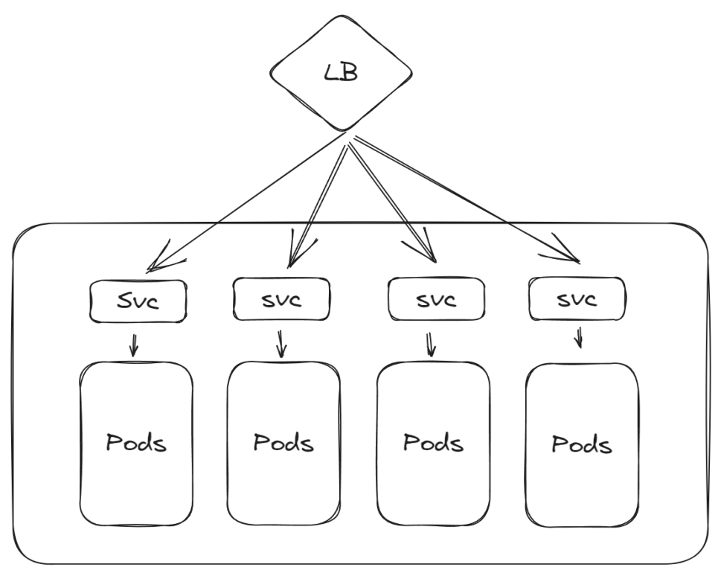
Micro services
Scalability and User experience
Each micro service will be standalone docker image deployed on kubernetes cluster. So each can independently of the other.
The HPA feature of kubernetes can be used to setup auto scaling for these pods.
Each microservices will be frontended by a load balancer which can distributed traffic equally between microservices.
Mobile/App consumers
Will be supported by a CDN like Akamai or AWS CDN to leverage caching at edge location for better user experience
Micro frontend architecture for the UI applications

Slide 6
Modernization Approach
Since I don’t know the logical diagram/current state of the Monolithic application. So the exact strategy cannot be recommended. However, broadly there are approaches like: continuous modernization (iteratively) or big bang approach.
Phase 1
Plan the modernization roadmap into incremental technical deliverables:
Data Ingestion and Consolidation
Data Governance
Services Scalability and Integration
User experience enhancements
Phase 2
Selection of the technical stack for the roadmap implementation
Selection of the monitoring tools for performance and logging
Phase 3
Design the scope of the implementation of the app components and integration with the existing applications.
Integration patterns will depends on existing monolith arch. Give me details to design in more depth.
Implementation of the Devops for the feature rollout of the applications
Implementation of the DEV, UAT, PROD environment for the CI/CD pipelines and testing.
Phase 4
Testing : regression, unit, e2e. Depending on the current state of the monolith application strategy can be planned for either blue/green or canary deployment. Assuming the monolith have some kind of api traffic splitting mechanism than we can easily do the blue/green approach.
Cut off and go-live

Slide 7
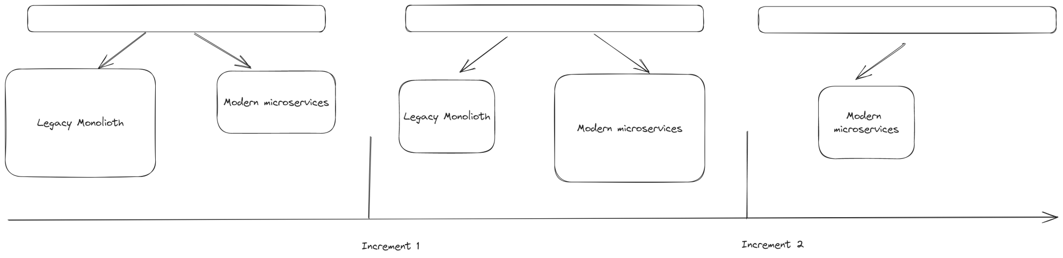
Modernization Approach
Since exact logical architecture is not given in problem statement. However on high level the migration strategy should look as mentioned above.
Idea is to iteratively modernize the existing application to the modern architecture.

Slide 8
Modernization Approach
Risk:
I assume some level of data migration will be needed from on-prem to cloud.
Rigorous testing will be needed.
DR and HA strategy need to be designed based on cost and expected RPO/RTO of the applications.
Cloud governance and monitoring support needs to be established to support applications after migration.
Zero down time while migrating the applications to the cloud.

